Slide 1

Welcome to LNG171-2
Dr. Jaclyn Fowler
Dr. Jackie

Slide 2
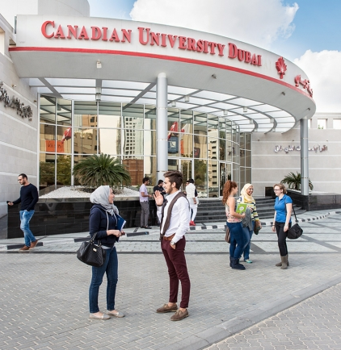
Office Hours D205-B
Sunday:
1:30-4:30
Monday:
9:00-10:00; 1:00-3:00
Wednesday:
9:00-12:00
Thursday:
9:00-10:00

Slide 3
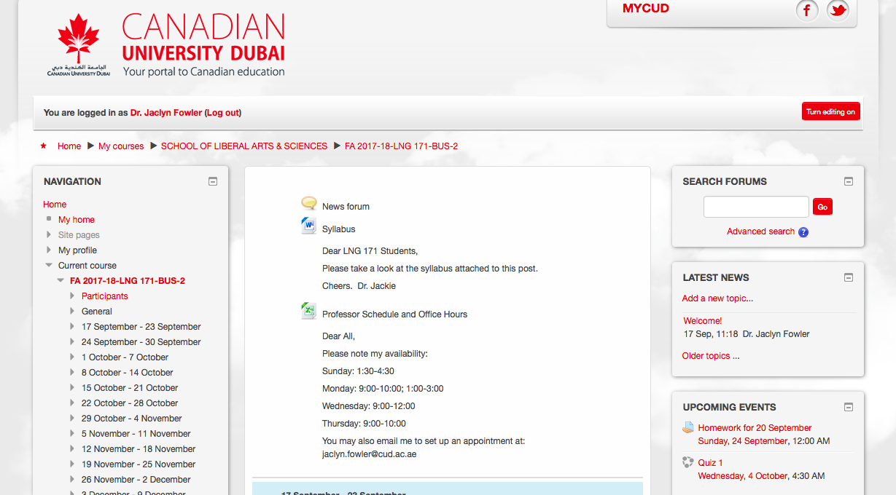

Slide 4
Syllabus—Daily Class Content and Assignments
Date | Class Content | Assignments Subject to Change
17 Sept. | Introduction Journaling Writing as Skill Simple Sentence (S) and Independent Clause (IC) Nouns:https://www.youtube.com/watch?v=DCdt8-H1BFY Verbs:https://www.youtube.com/watch?v=US8mGU1MzYw SC1: IC; ic. | Read: Suzanne Britt, Neat People vs. Sloppy People: http://officeinstructor.com/EssayWriting/EssayPDFs/Neat%20vs%20Sloppy.pdf Journal 100-150 words on one (1) point the author made about sloppy people and the evidence she used to support it. (Use at least one (1) Ic; ic.).

Slide 5
Syllabus-Graded Assignments
Activity | Value
In-class Assignments Quizzes (10 points) In Class Writing (10 points) Journal (10 points) | 30 points
Presentations Presentation 1 (10 points) Presentation 2 (10 points) | 20 points
Midterm Exam | 20 points
Final Exam | 30 points

Slide 6

SEntence
Independent Clause (IC)

Slide 7
Simple Sentence vs. Independent Clause
Has a Subject
Has a Verb
Expresses a Complete Thought
Has a Subject
Has a Verb
Expresses a Complete Thought

Slide 8
Nouns
Noun: The name of a person , place, thing, or idea

Slide 9
Verbs
Verb: A word that describes the action, being, or occurrence in a sentence.

Slide 10
Sentence-Combining 1: Using a semicolon (;)
IC;ic.

